Slide 1

Metrocar Customer Funnel Analysis
Vanessa Kimana

Slide 2

Project Background
Metrocar operates as a ride-sharing platform
Connects riders with drivers through a mobile application
Acts as an intermediary between riders and drivers
Analyze Metrocar's customer funnel for improvement

Slide 3
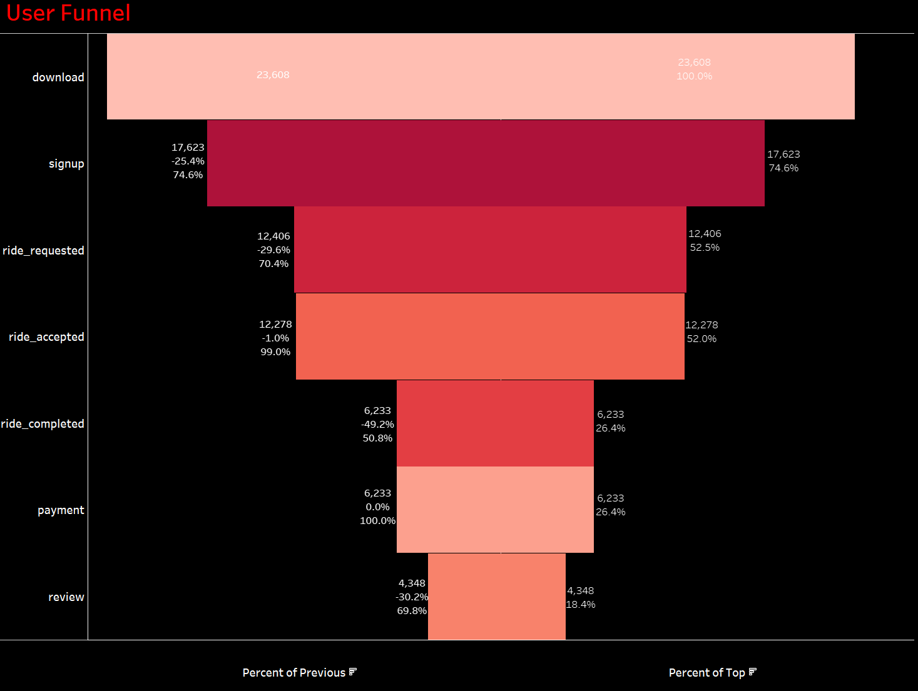
User Funnel Analysis

Slide 4
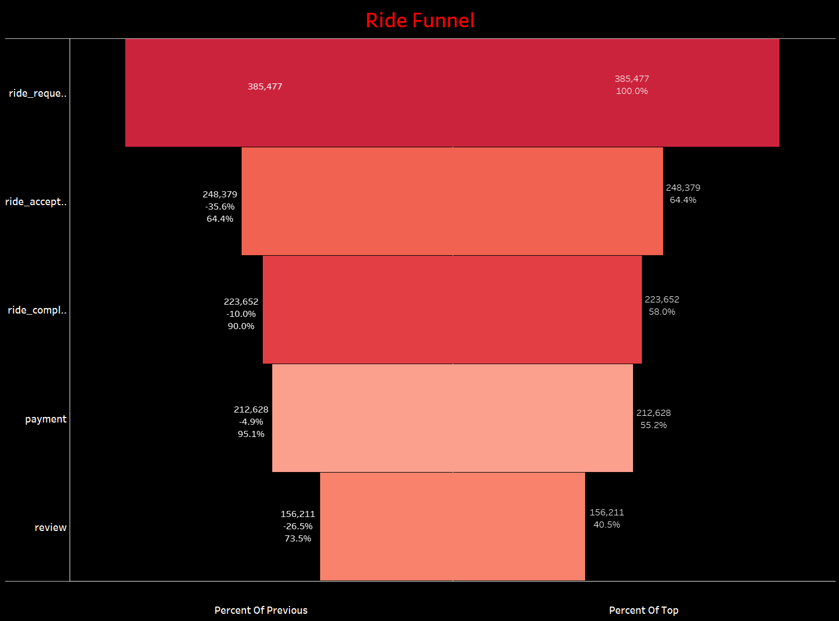
Ride Funnel
Is the average amount spent per user different between the two groups?
Difference in spending between the two groups was quite small. People in both groups spend about the same amount.
The actual difference in spending probably falls within a range of -$0.47 to $0.44. Not sure of a positive effect
The impact could be either positive or negative within this range

Slide 5
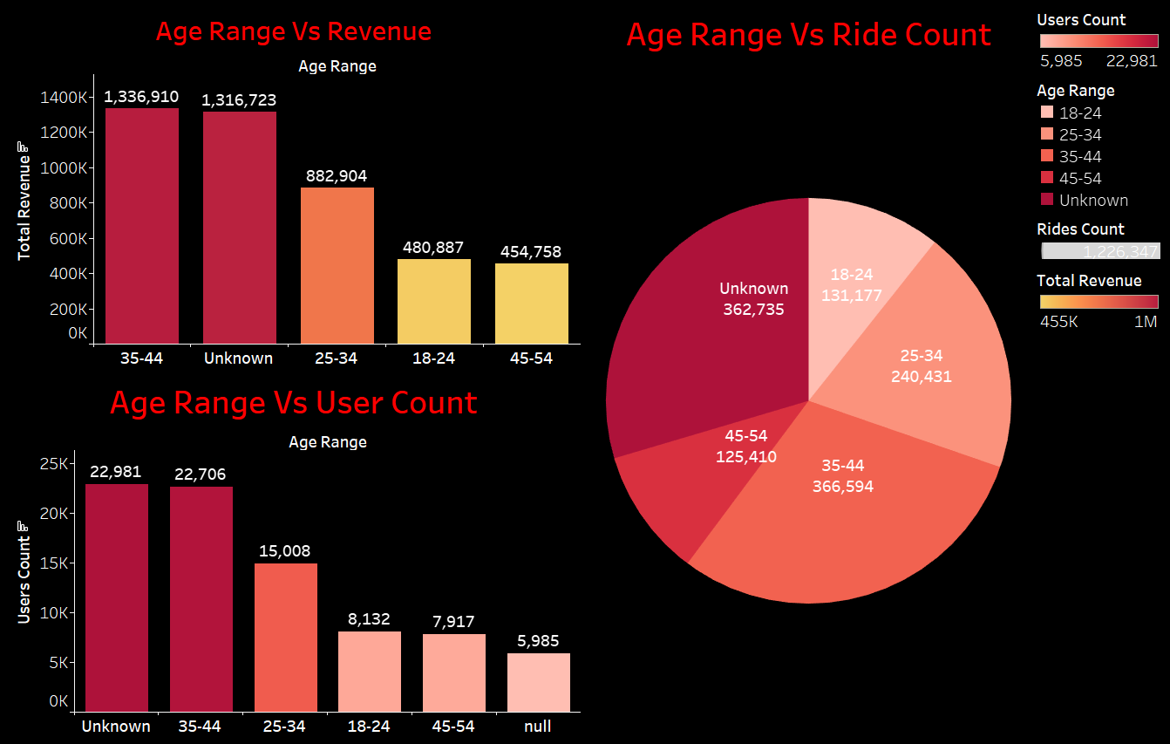
Age Range Vs Revenue Vs Ride
Is the conversion rates different between the two groups?
The significant difference in conversion rates between Group A and Group B, highlighted by the Z-Score of 3.865.
Group B is performing better in terms of conversions, with a true difference in conversion rates falling between 0.0035 and 0.0107

Slide 6
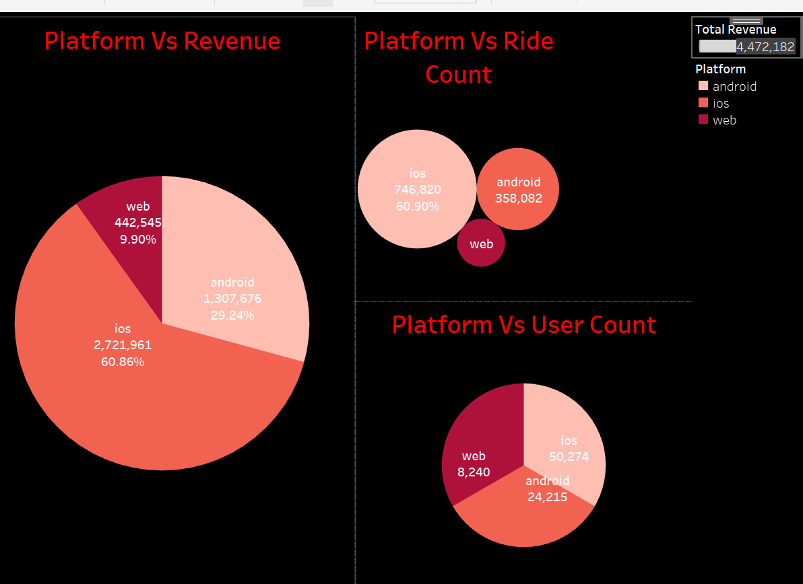
Platform, Revenue, Ride & User Count Analysis
Females demonstrate higher conversion rates in both Group A (5.1%) and Group B (5.4%), although the average conversion rate is slightly greater in Group A
Group B saw a 6.5% conversion rate among iPhone users, surpassing Group A at 5.9%. Group B also had higher average conversion among Android users

Slide 7
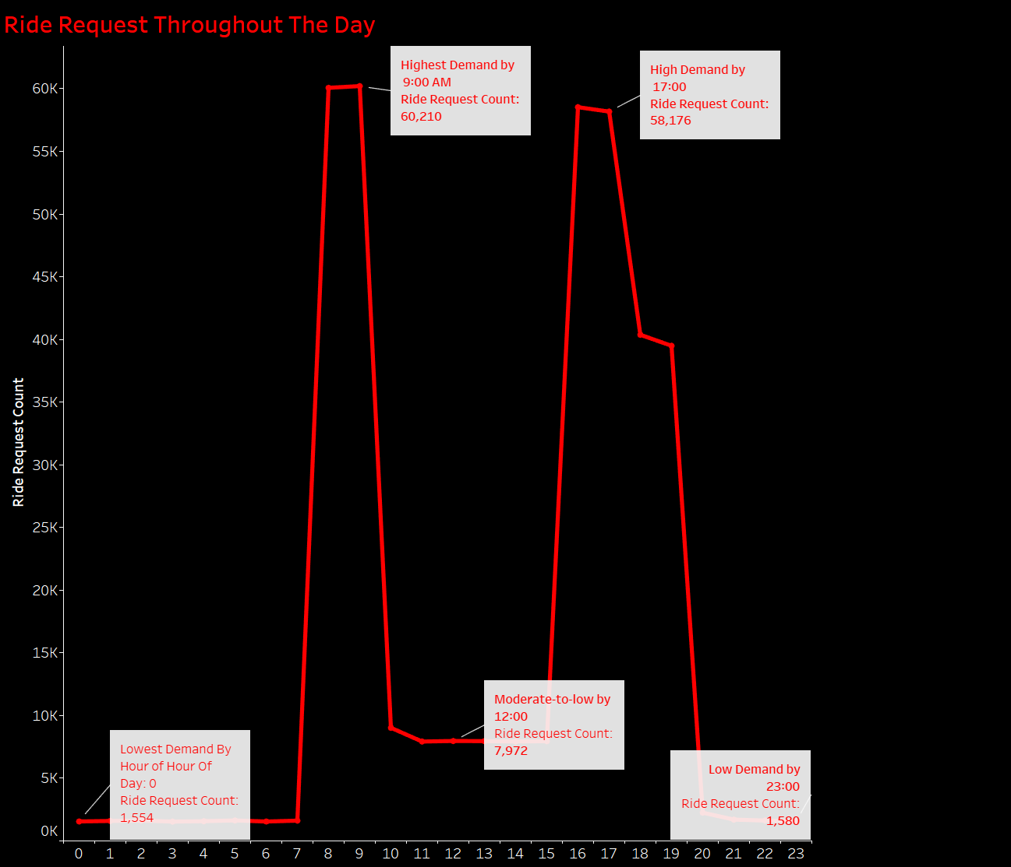
Ride Request Throughout The Day
Thought the average amount spent by users in both groups remained relatively similar, treatment group shows a notable 18% higher conversion rate compared to the control group
The banner for the food and drink category has a statistically significant positive impact on user conversion rates
This suggests that the banner is successful in prompting users to make purchases but does not significantly influence their spending habits.
To maximize the impact of this banner, my recommendation is to focus on optimizing user engagement and encouraging repeat purchases
Consider various factors and engage with all project stakeholders to optimize and maximize the benefits of this experiment's launch

Slide 8

END OF PRESENTATION

